Slide 1



SolarEase
supervised by
Prof. Abeer ElKorany
Implemented by
Name | ID
Mariam Ashraf Amin | 20200520
Mariam Saeid Shawky | 20200521
Sarah Ahmed Mahmoud | 20201085
Hoda Shafek Ahmed | 20200619
Eman Mustafa Fathy | 20201040
Graduation Project Presentation
Academic Year 2023-2024
Final Presentation

Slide 2
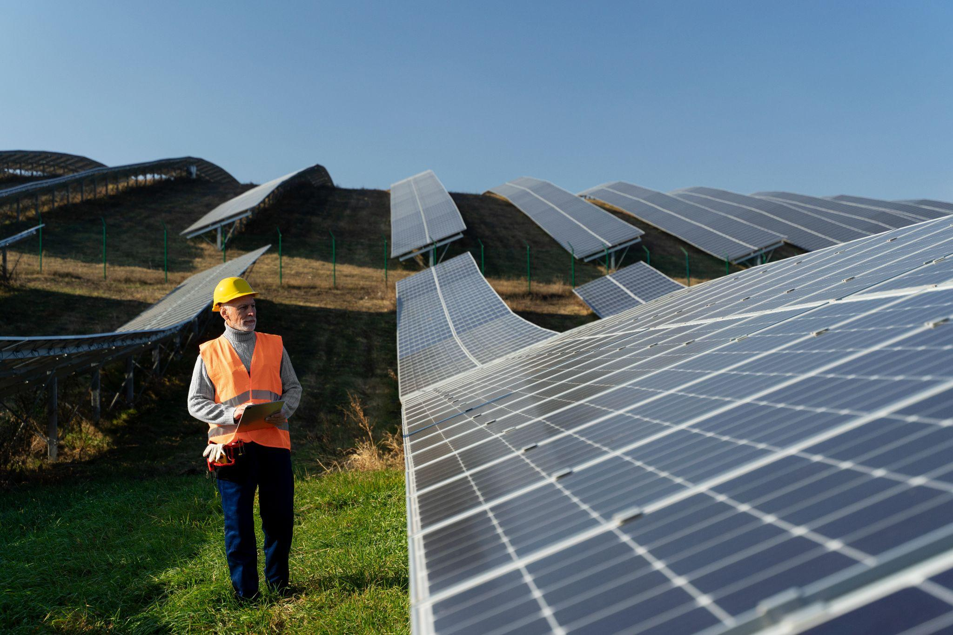
Table of contents
01.
02.
03.
04.
Project Idea
Problem Significance
Project Specifications
Time Plan
05.
Conclusion

Slide 3
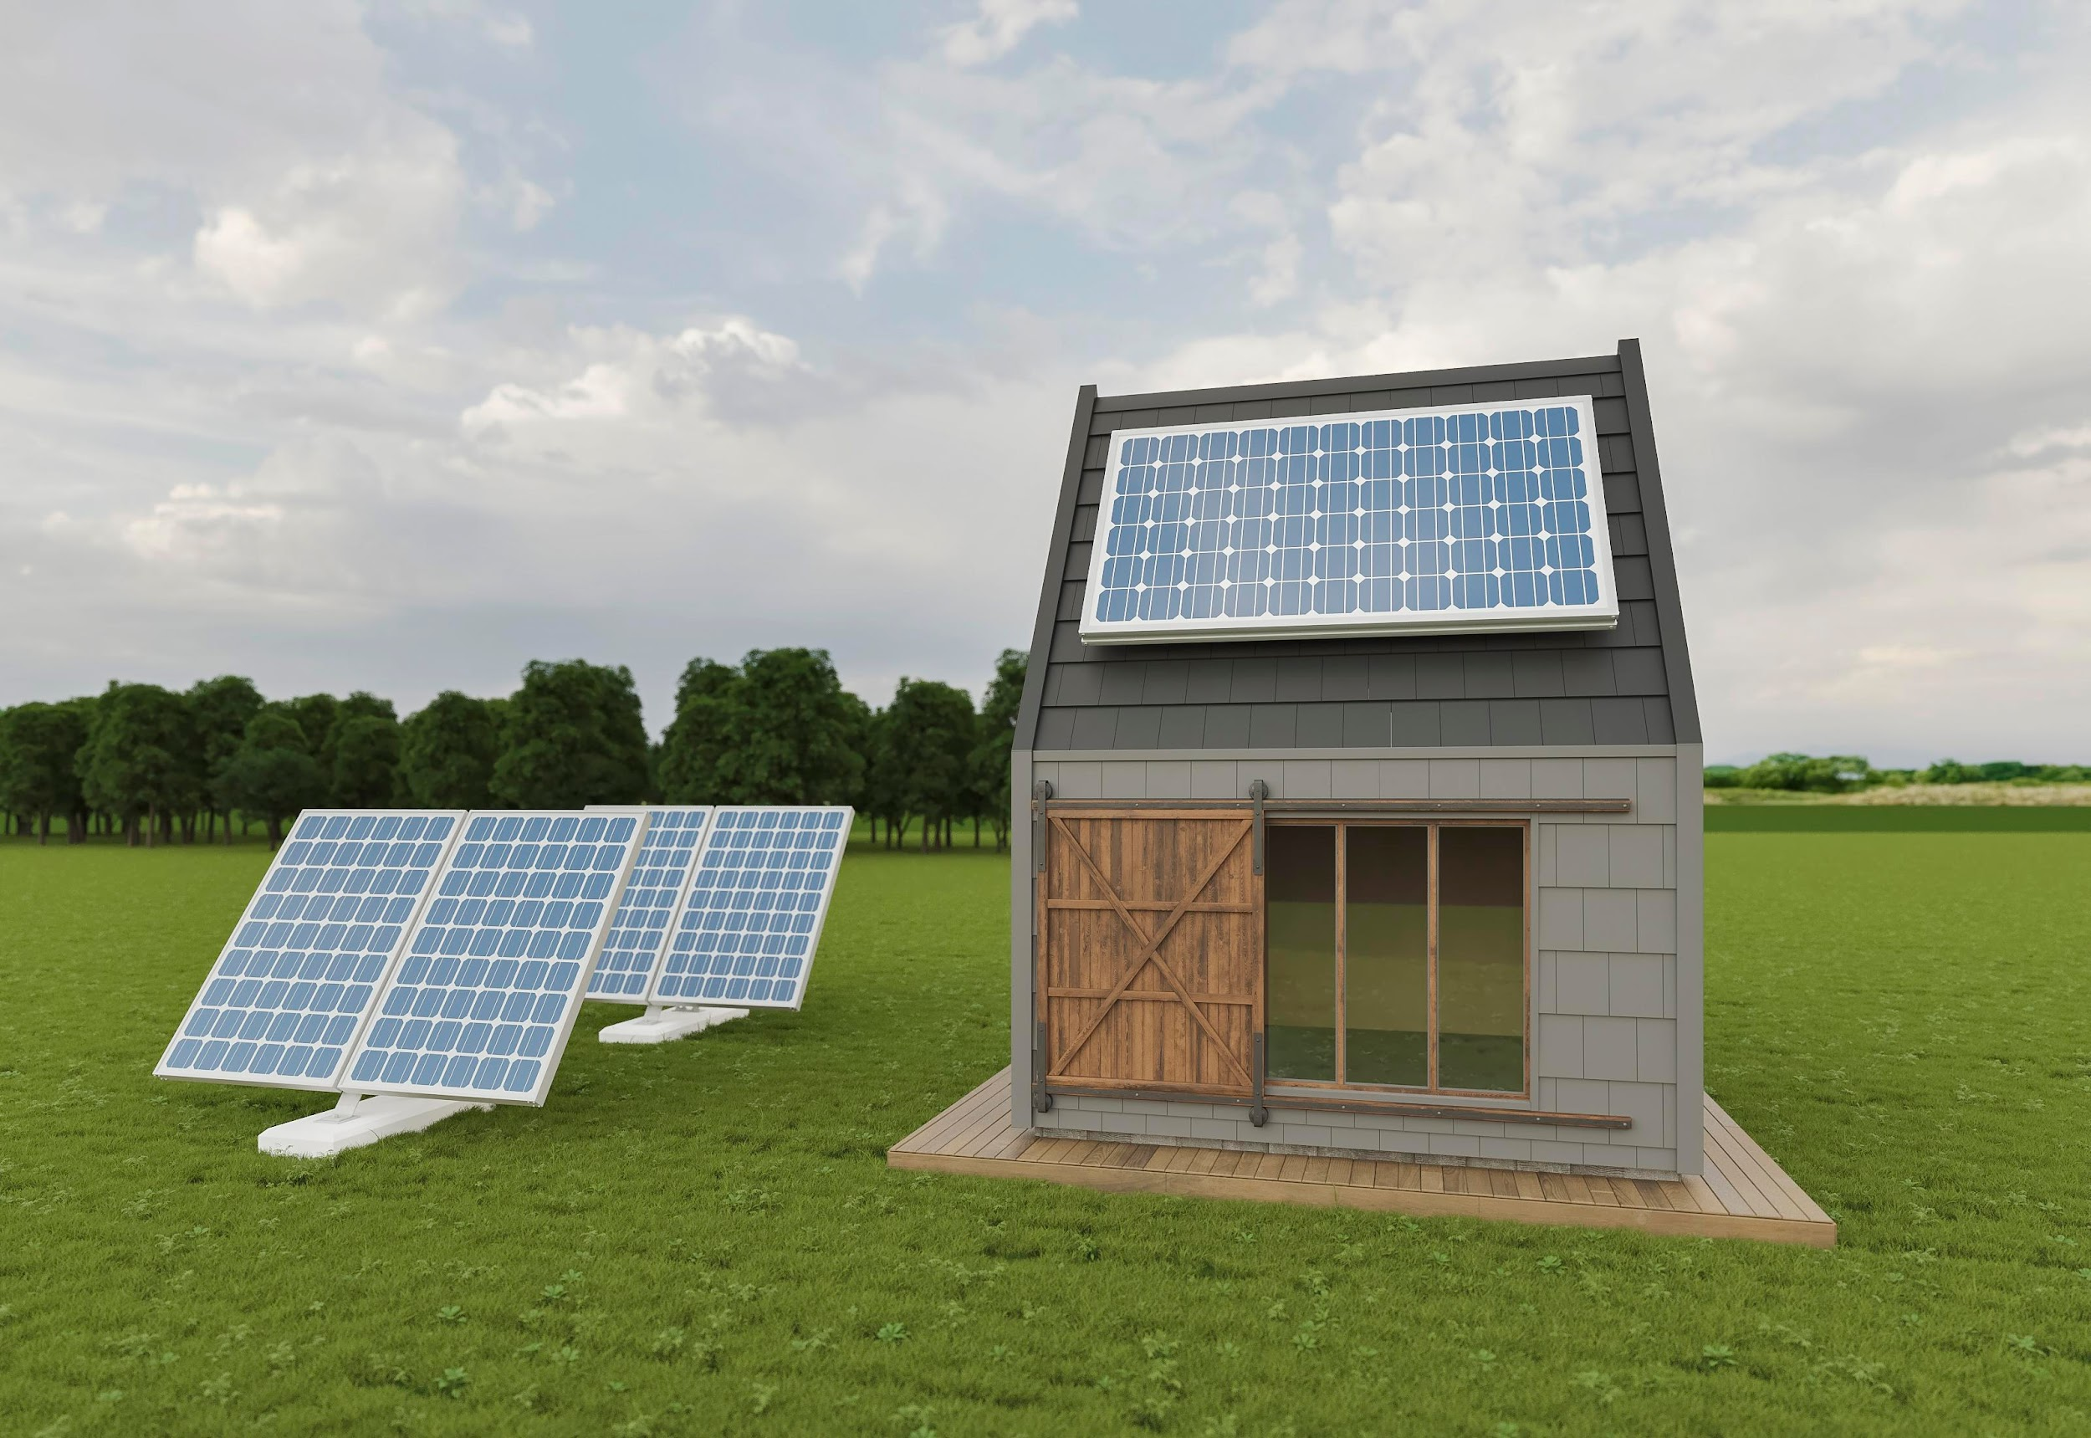
01.
Project Idea
Ideas That Shaped Our App Innovation

Slide 4


Project Idea
Mitigate climate change by automating the process of reducing carbon emissions resulting from using conventional electricity. We achieve this by raising awareness about solar energy and assisting users in determining the right solar system for them.

Slide 5
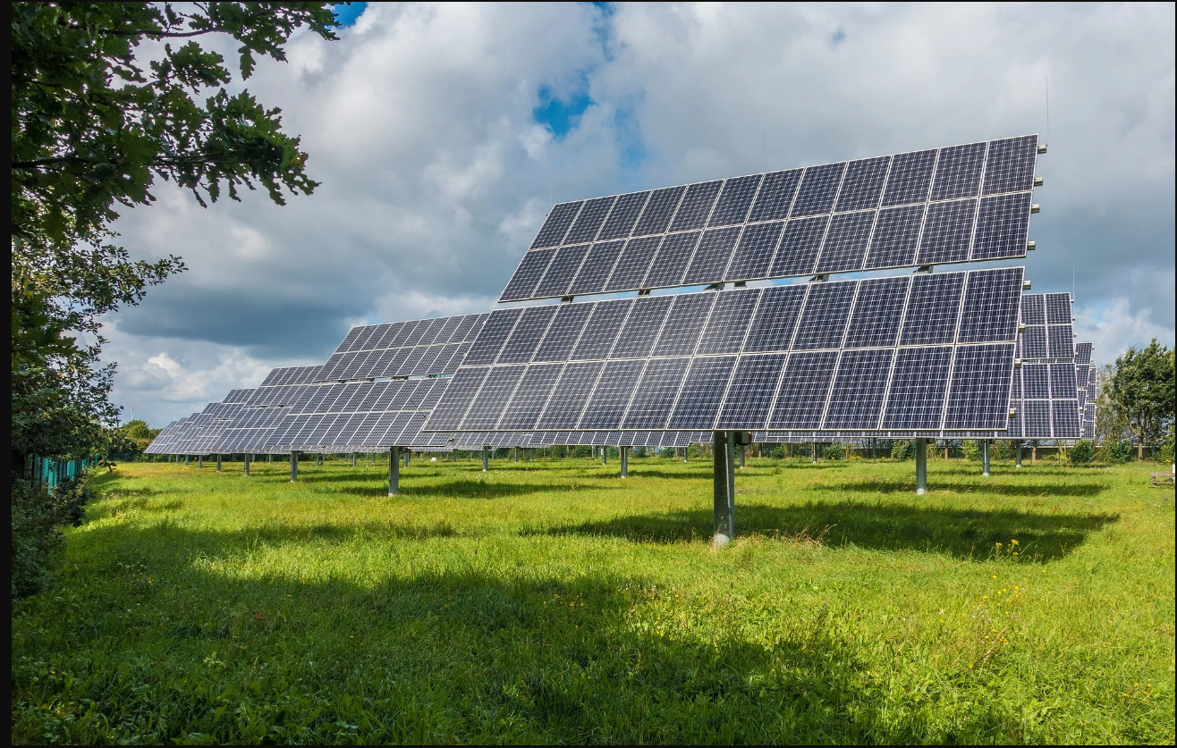
Problem Significance
Problems, Why and How? , Pervious Solutions

Slide 6
Problems
Awareness:
People underestimate how solar systems can help the environment and positively affect climate change.
People struggle to find clear details about solar installation process.
It is hard to determine whether solar energy is suitable for users and financially beneficial in the long run or not.
People may not be aware of government permits or financial support.
Facilitating:
Complicated calculations needed to figure out solar savings and payback time and solar system output.
Finding trustworthy solar installers and suppliers is hard.

Slide 7
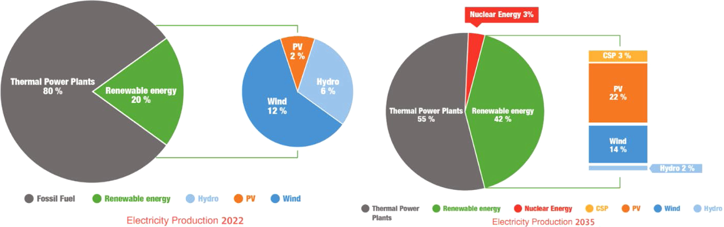
Why?
Our planet is experiencing rising temperatures and extreme weather events.
Egypt possesses abundant solar energy potential to mitigate climate change.
People are not aware enough of this not-exploited energy.
The Egyptian government's efforts and the Vision 2030 initiative.
Given the continuous rise in electricity prices, finding a lasting solution is essential.

Slide 8

How To Solve ?
03.
01.
Facilitate the buying and selling of solar components.
Assisting users in choosing the right solar system efficiently.
04.
Predict solar system productivity.
02.
Calculate solar system payback period, financial and environmental impact.
05.
Integrate a chatbot for information and terms.

Slide 9


Previous Solutions
Features
 |  | PV Output WebSite | Energy Sage WebSite (2009) | PVWatts WebSite (2012) | Solar Reviews WebSite (2012) | Solar Market Egypt WebSite (2018) | Know Solar App (2021) | Solar .com Website (2023) | SolarEase (Our App)
 | SolarCalculator Solar System Size & Cost Calculator
 | SolarSaving Cost Savings & Payback period
 | SolarEnergyPredictor Predict Solar Panels Production (Hourly – Daily)
 | SolarInstallerFinder Solar Companies & nearby companies
 | SolarMarketPrices Products Price & Favorite Products
 | OnlineTradeMarketPlace Favorite Posts
 | SolarGreenImpact Environmental Savings
 | SolarChatBot
Solutions
Decision Making
Installation
Awareness

Slide 10
Project Specifications
System Architecture
Functional Requirements
Non-Functional Requirements
Stakeholders
Sequence
Diagram
Class Diagram
Use-Case Diagram
Entity Relationship Diagram

Slide 11
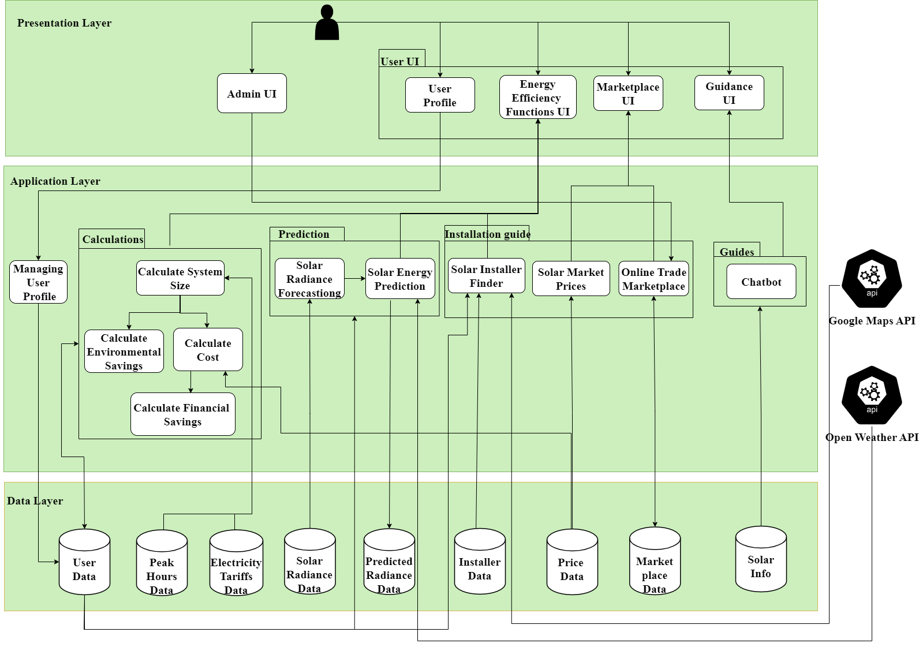
System Architecture

Slide 12

Stakeholders
01.
Customers
02.
Companies
03.
Administrators

Slide 13
Functional Requirements
01
Calculate System Size
06
Find Solar Installers
02
Calculate Cost
07
Solar Market Prices
03
Calculate Financial
Savings
08
Online Trade
Marketplace
04
Chatbot
Calculate Environmental Savings
09
Predict Solar Energy
Filter Posts
05
10

Slide 14
Non-Functional
Requirements
01.
Usability
02.
Performance
03.
Scalability
04.
Reliability
05.
Data Integrity
05. Data Integrity

Slide 15
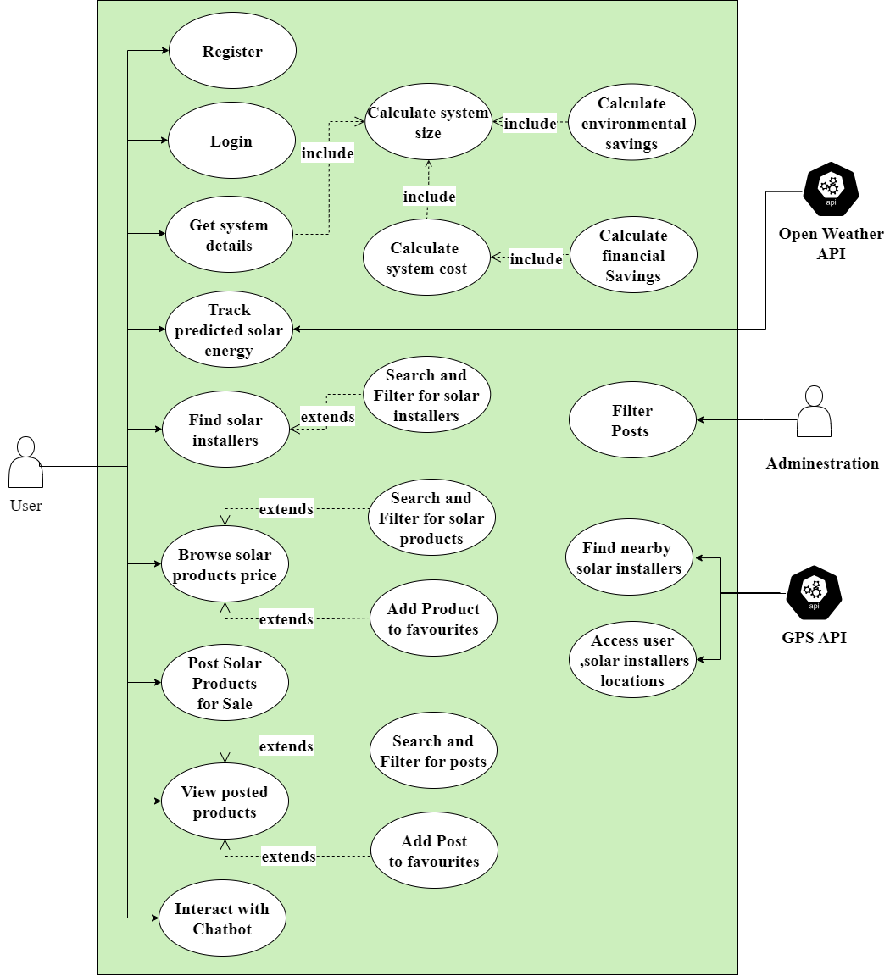
Use-Case
Diagram

Slide 16
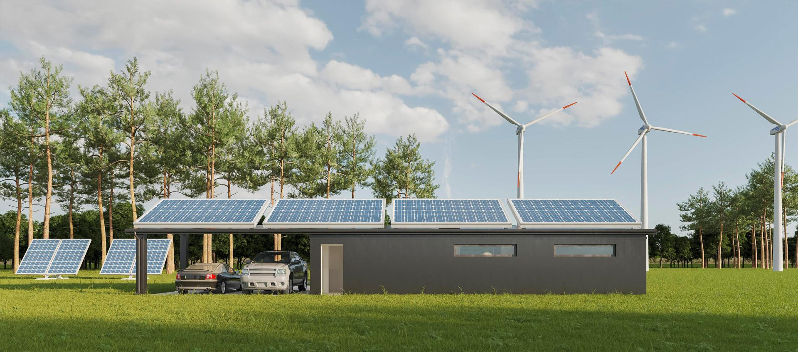
Time Plan
Previous 8 Months

Slide 17

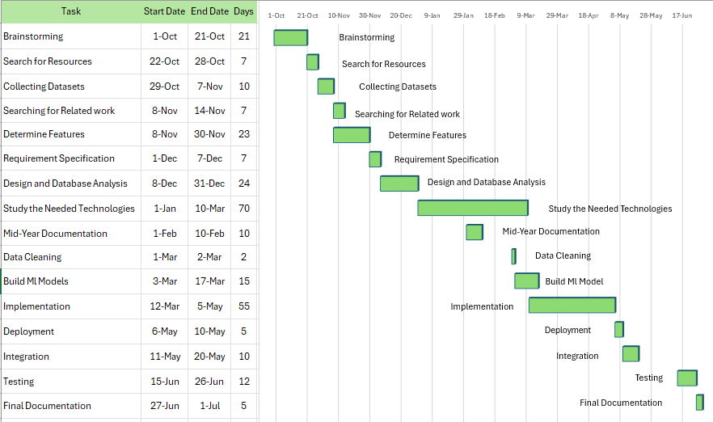
Time Plan

Slide 18
Implementation
Front-End
Back-End
Demo
Features

Slide 19




Front-End & Back-End
Technologies
.
.
.
.
.
05. Data Integrity

Slide 20
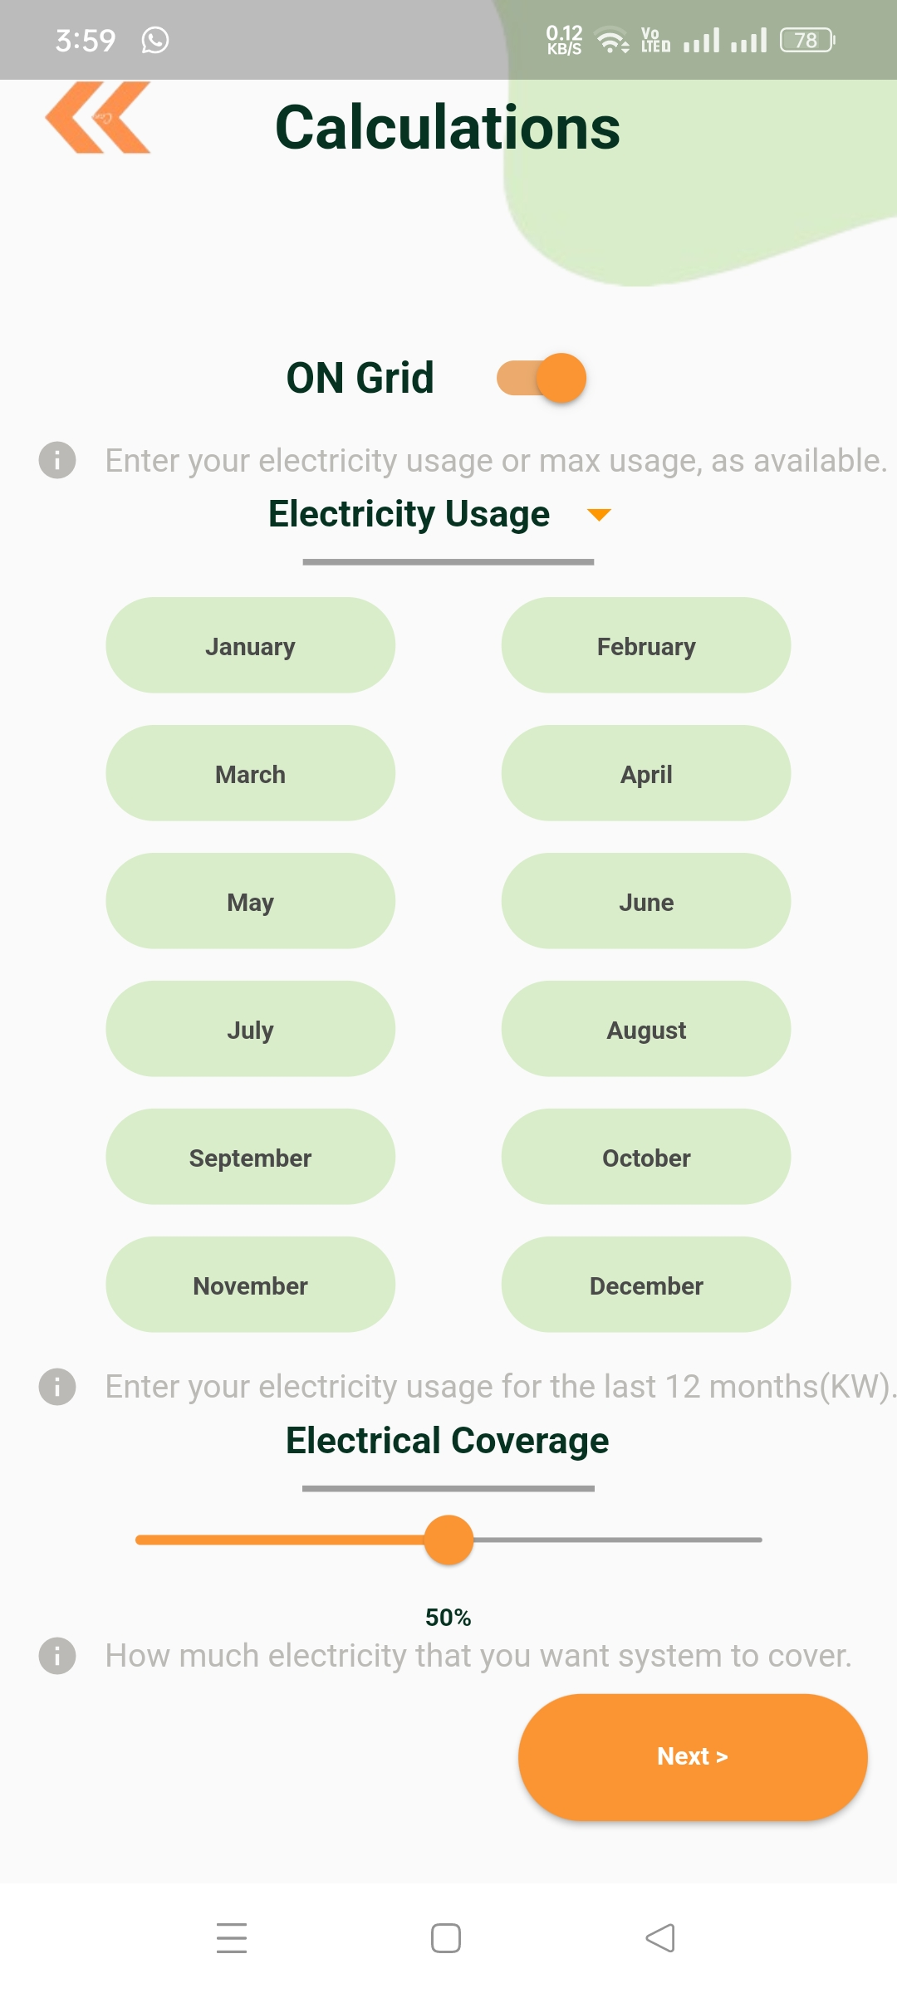
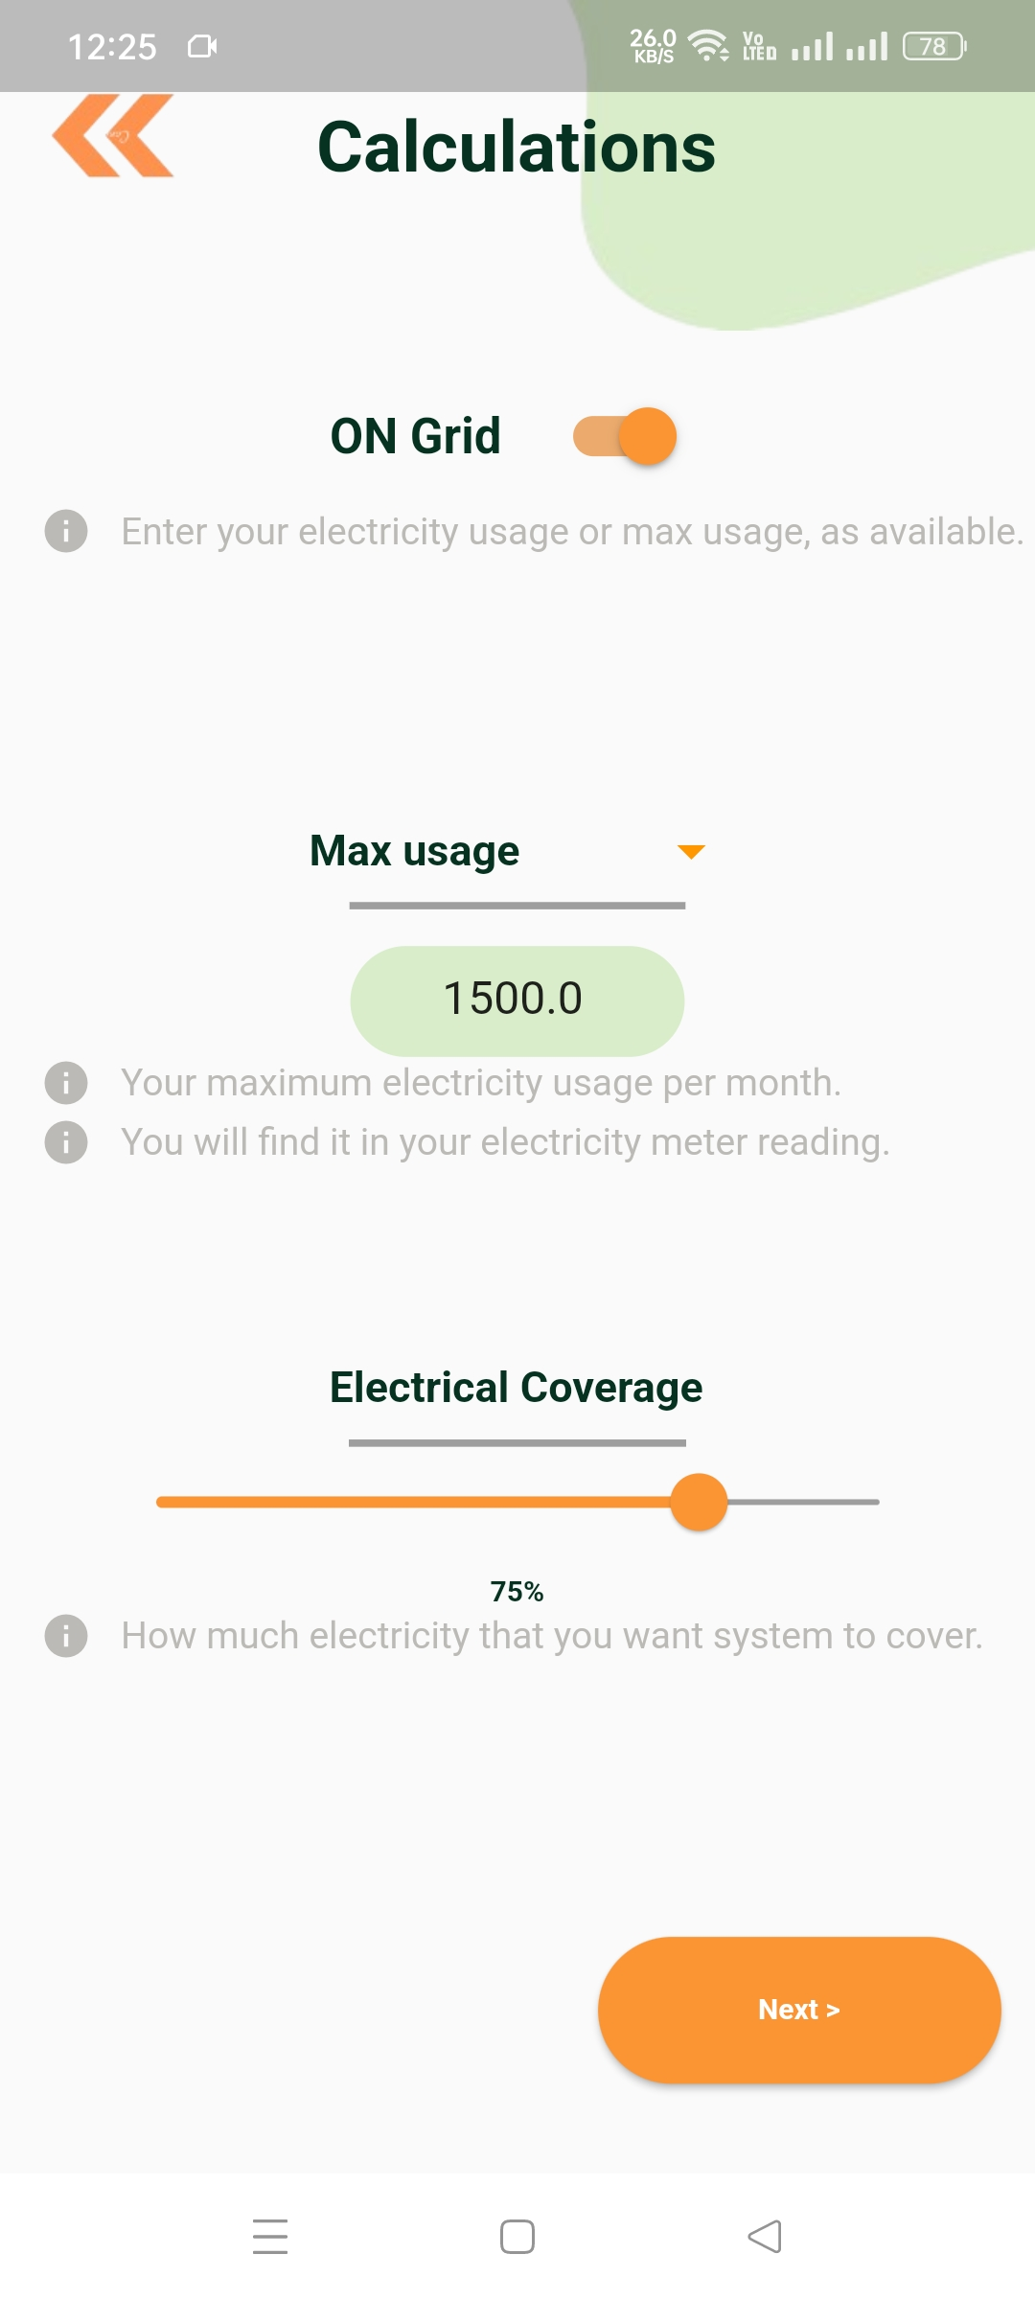
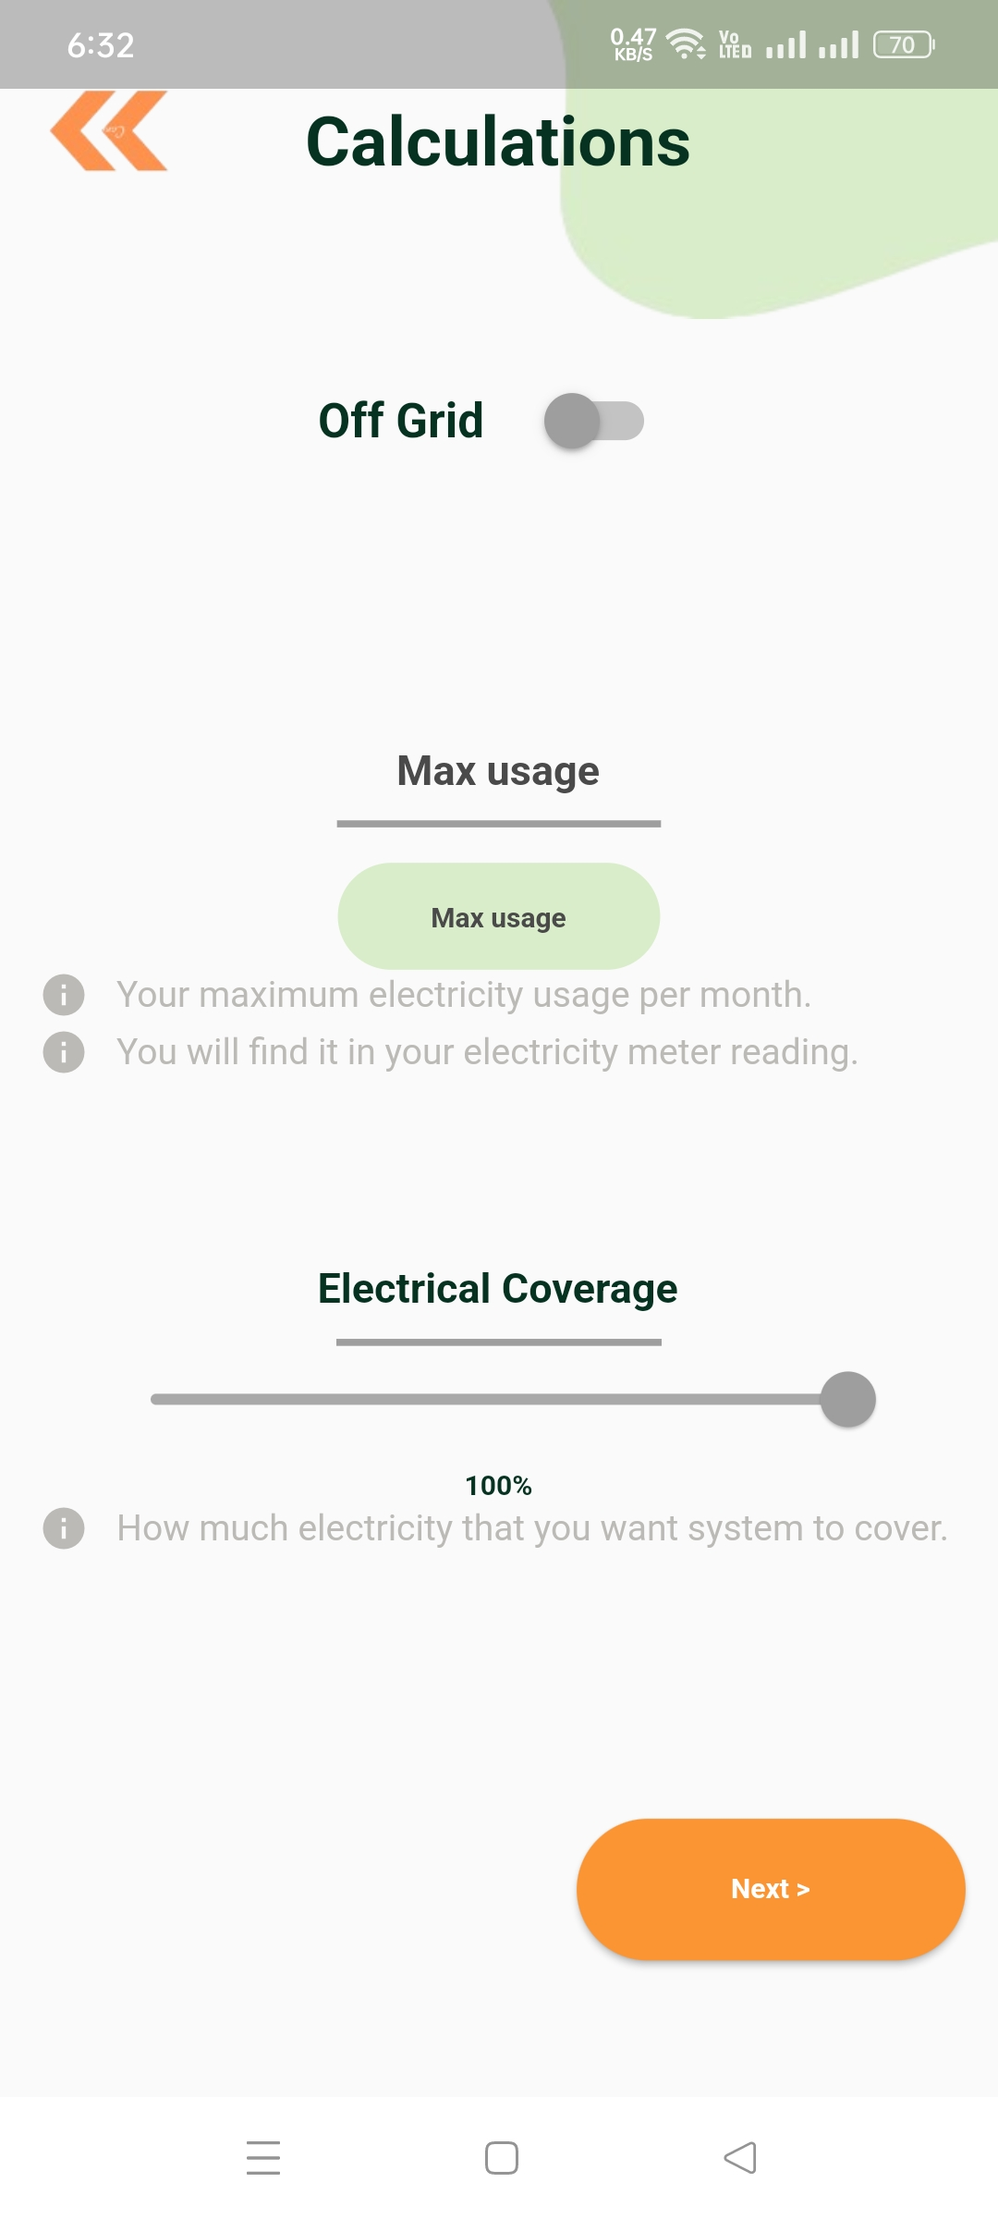
Calculations
User inputs electricity consumption for the last 12 months, if available, in an on-grid system
If data for the last 12 months is not available, the user enters the maximum electricity consumption (max load) in an on-grid system
The user inputs the maximum electricity consumption (max load) in an off-grid system

Slide 21
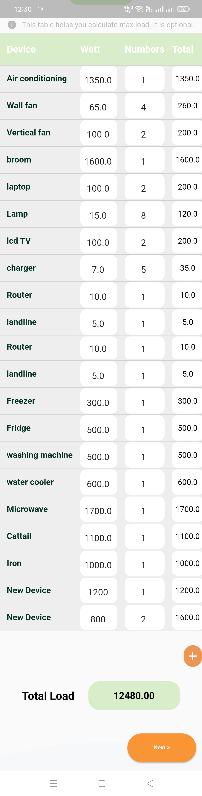
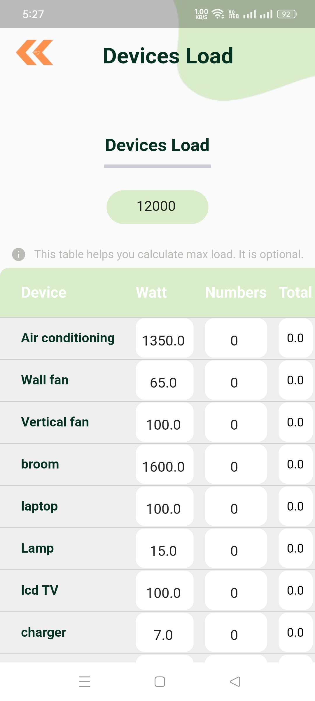
Calculations
To determine inverter capacity, user can do one of the following:
1) Enters an estimate for the total device load.
2) Enters load for each device and its number in their home.

Slide 22
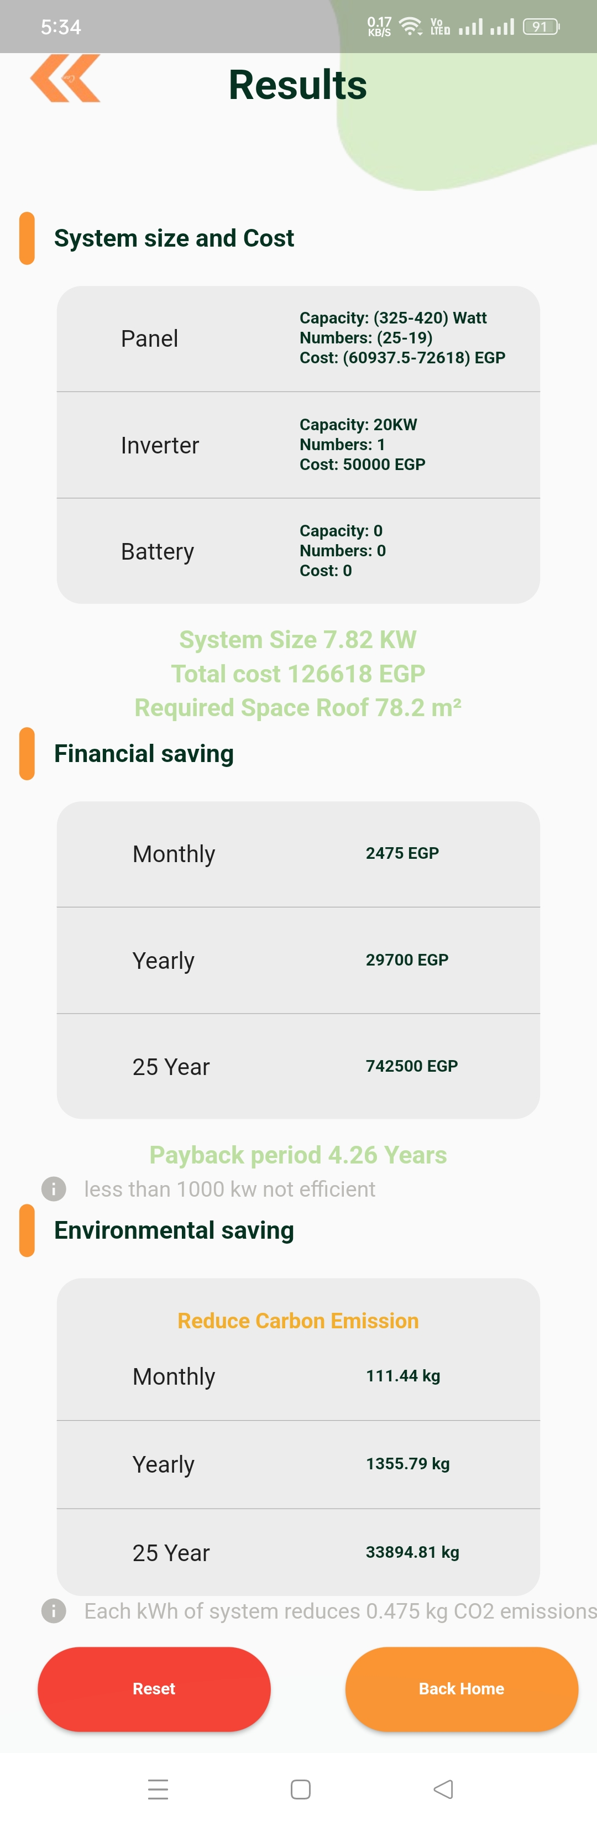
Calculations
This solar system calculator estimates the size and cost of a system based on user electricity usage and sunlight hours. It considers roof space, number of panels, inverter type and cost to provide a comprehensive cost estimate.
The financial savings calculation estimates monthly, yearly, and 25-year savings by comparing electricity costs before and after solar installation. The payback period calculation determines the time to recover the solar investment, using total system cost and yearly savings.
Estimates the reduction in CO2 emissions monthly, yearly, and over 25 years, based on 0.45-0.5 kg of CO2 saved per kWh of solar energy compared to fossil fuels.

Slide 23
Daily Model
&
Hourly Model
Dataset
Solar and meteorological data sets from NASA POWER for all 27 governorates of Egypt.
Training Data
1/1/ 2014 -> 31/12/2023
Testing Models
Daily model : 1/1/2024 -> 1/6 2024
Hourly model : 1/1/2024 -> 1/3 / 2024
Algorithm
Use SVR through extensive hyperparameter tuning using GridSearchCV

Slide 24
Our Experiments
Comparison of Our SVR and FNN Models Tested for Daily Solar Irradiance Prediction
Model
 | SVR | FNN
R2 | 0.844 | 0.768
MAE | 0.405 | 0.505
Matrices
Literature Review
Daily Model
Meenal and Immanuel Selvakumar (2018)
Hourly Model
Muhammed A. Hassan et al. (2017)
Model
 | Paper SVR | Our SVR (Cairo)
R2 | 0.90 | 0.949
 | Paper SVR | Our SVR (Cairo)
R2 | 0.911 | 0.844
Model
Matrices
Matrices
The study concluded that SVR outperformed ANN SVR effectively captures complex relationships within meteorological datasets, making it the best choice for solar irradiance prediction.
The study investigated tree-based ensemble methods for modeling hourly solar radiation across five solar-meteorological stations. They compared SVR, MLP, and DT for hourly solar radiation forecasting

Slide 25
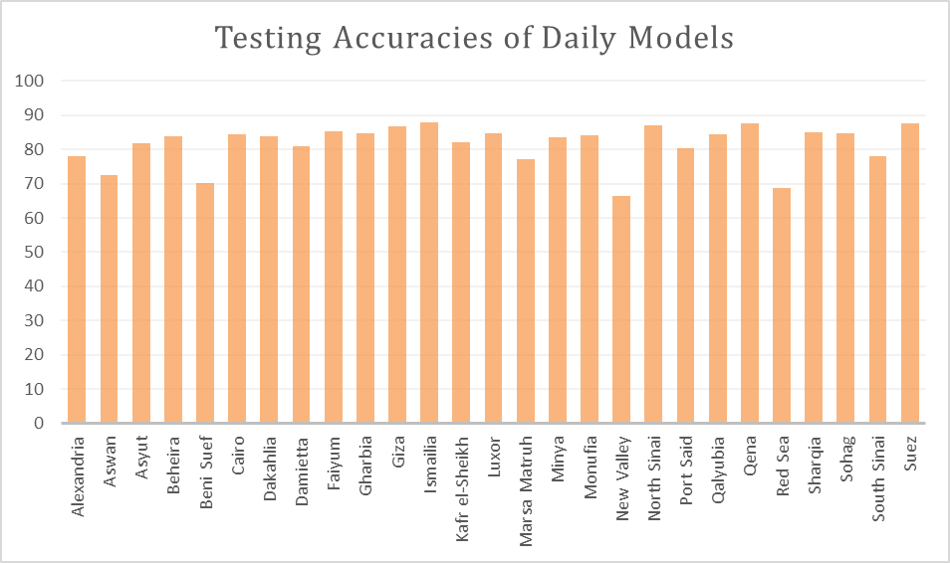
Daily Testing
Daily testing accuracies for all 27 governorates SVR models

Slide 26
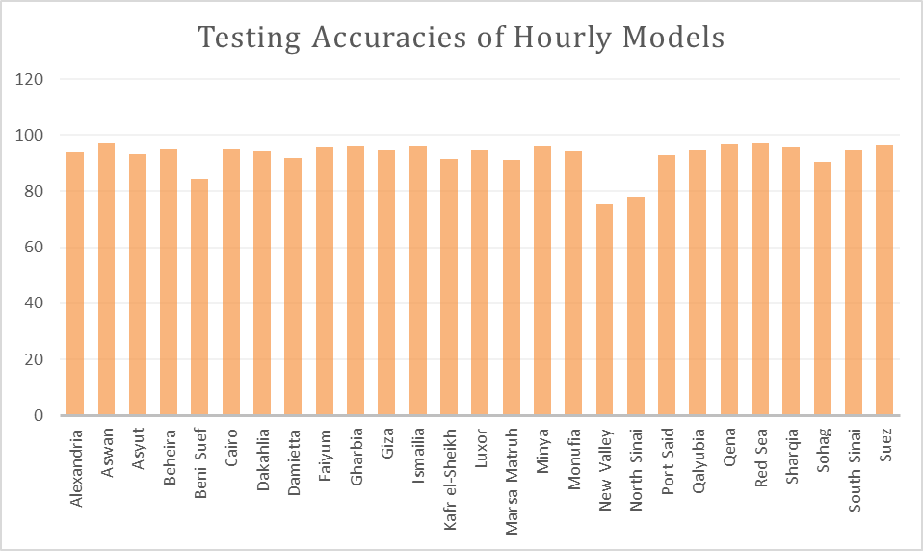
Hourly Testing
Hourly testing accuracies for all 27 governorates SVR models

Slide 27
Daily Model Testing Examples
Location | Luxor |  | Port Said
Date | 2024-03-12
Meteorological Data | T2M: 22.35 RH2M: 15 | PS: 98.62 WS10M: 2.1 | T2M: 18.38 RH2M: 63 | PS: 101.45 WS10M: 3.59
 | PRECTOTCORR: 0.0 |  | PRECTOTCORR: 0.0
Predicted Solar Irradiance | 6.83 |  | 5.6
Actual Solar Irradiance | 6.44 |  | 5.5
System 5 kW
System 5 kW
25.61 KW
21 KW
Surface shortwave downward irradiance (kW-hr/m^2/day), temperature (T2M), wind speed at 10 meters (WS10M), pressure (PS), corrected precipitation (PRECTOTCORR), and relative humidity at 2 meters (RH2M)

Slide 28
Hourly Model Testing Examples
Location | Asyut |  | Cairo
Date | 2024-02-27 11:00
Meteorological Data | T2M: 21.84 RH2M: 28.5 | PS: 99.77 WS10M: 6.46 | T2M: 20.44 RH2M: 43.38 | PS: 100.05 WS10M: 5.26
 | PRECTOTCORR: 0.0 |  | PRECTOTCORR: 0.0
Predicted Solar Irradiance | 829.53 |  | 672.53
Actual Solar Irradiance | 853.75 |  | 666.19
System 5 kW
System 5 kW
3.11 KW
2.52 KW
Surface shortwave downward irradiance (Wh/m^2), temperature (T2M), wind speed at 10 meters (WS10M), pressure (PS), corrected precipitation (PRECTOTCORR), and relative humidity at 2 meters (RH2M)

Slide 29


Real-Time Solar Irradiance Prediction
1.
1.
Overview
Data Integration
Scalability
Models Deployment
We provide real-time solar irradiance predictions every 3 hours and daily, over five days across all governorates of Egypt.
Our models integrate with the OpenWeatherMap Api
to retrieve real-time features such as temperature, wind speed, which are then utilized as input features SVR models.
Our models are designed to handle different geographic locations across Egypt.
Our prediction models Hosted and managed on the Hugging Face cloud platform.

Slide 30
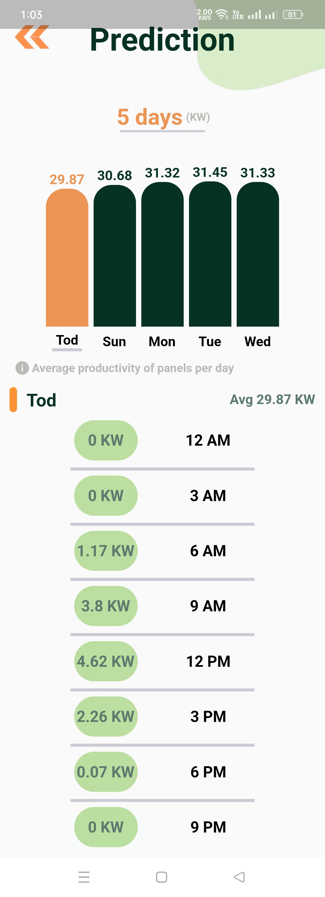
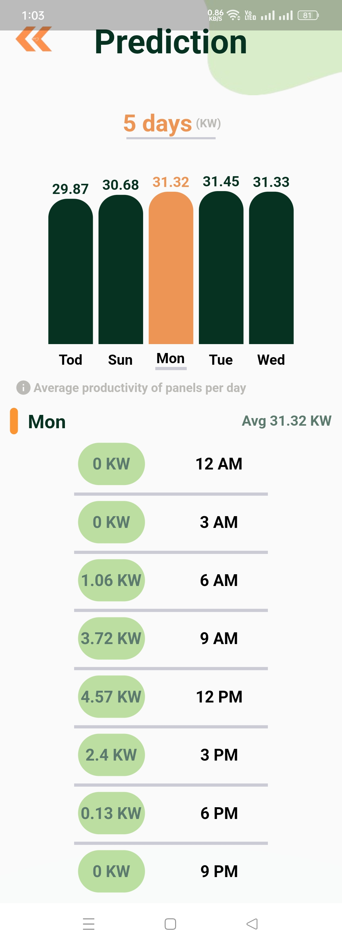
System Output Estimation
Daily electricity output in kW over 5 days.
Users can navigate through the days to view electricity output every 3 hours for each day.
Each day includes electricity output data every 3 hours.

Slide 31
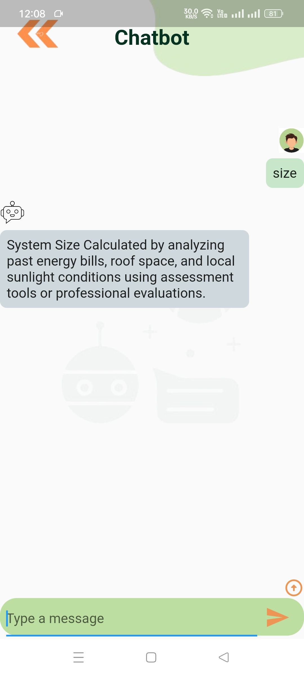
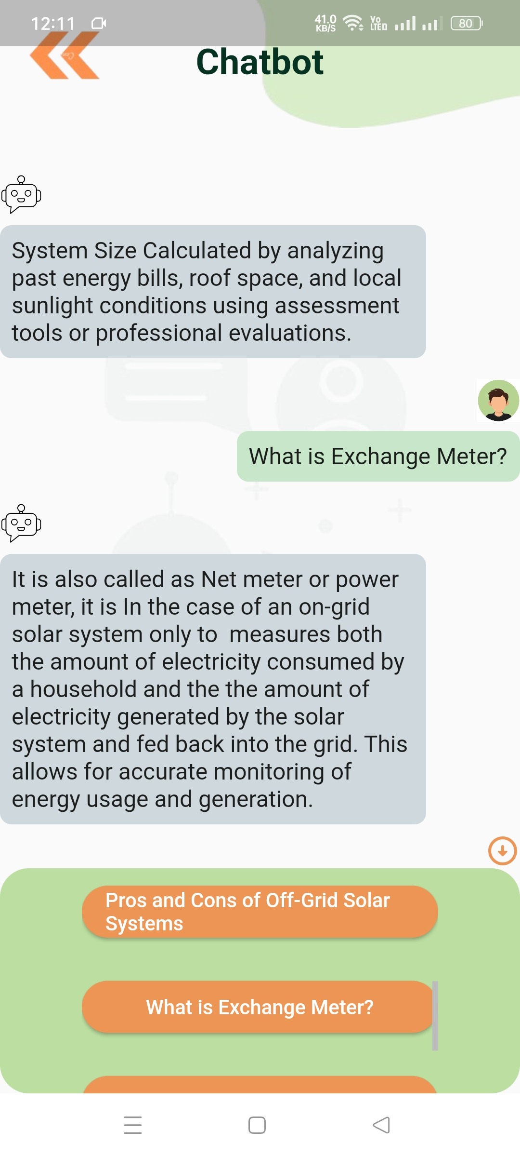
Chatbot
Category-Based Question Chatbot:
Interactive Chatbot:
For predefined responses triggered by specific keywords and phrases in the user's input, we utilize NLTK techniques such as tokenization, stemming, and Jaccard similarity. ensures accuracy.
Users receive answers generated from predefined responses.
Allows users to choose solar energy categories, browse related questions within each category, and select specific questions, enhancing access to solar energy information.
Allows users to input questions.

Slide 32
Chatbot Literature Review
A Thai-language chatbot
using Jaccard similarity
Chanakot and Sanrach (Feb 2024) developed a Thai-language rule-based chatbot that matches user symptoms with disease databases using Jaccard similarity, increasing disease identification accuracy.
Jaccard Coefficient for
Keywords Similarity
Niwattanakul et al. (2013) optimized information retrieval in search engines using Jaccard similarity , comparing its effectiveness with other similarity measurement techniques like cosine similarity, Vector Space model, and Engram. The study highlighted Jaccard’s performance over alternative similarity measurement techniques in enhancing search result relevance despite challenges with typographical errors.

Slide 33
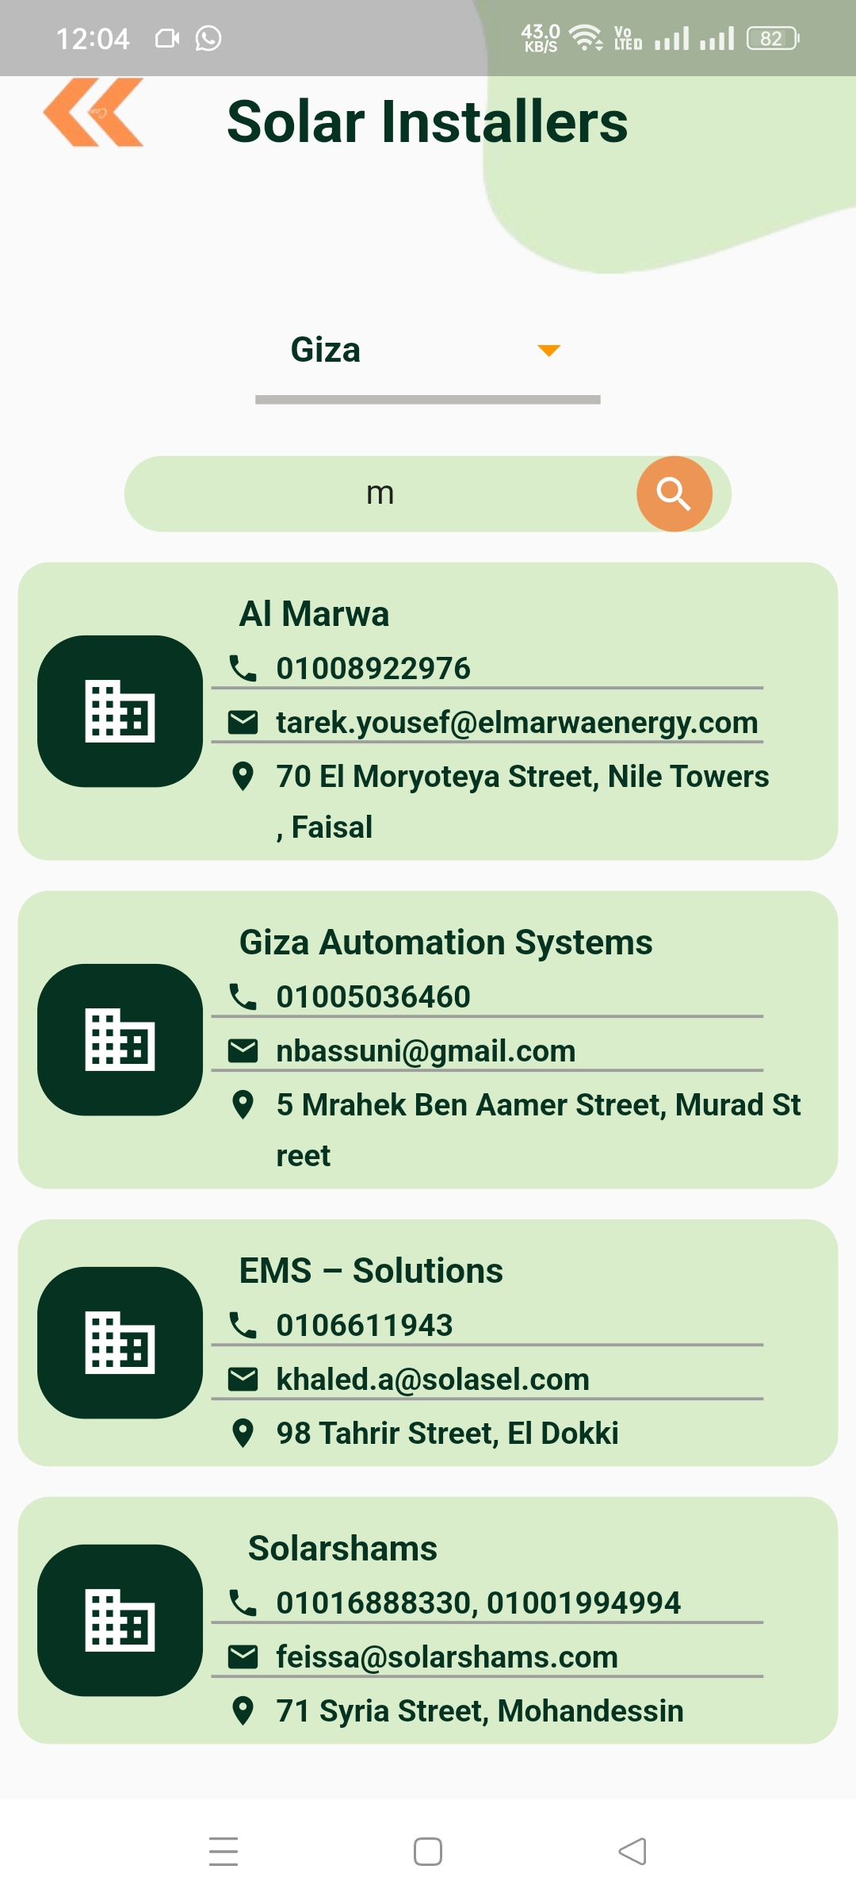
Find Solar Installers
Offers filtering by city.
Users can view all certified solar installer companies in Egypt, sorted by nearest to user.
Searching by company name for tailored selection of certified solar installers.
We used two Google Maps APIs, the Geocoding API and the Distance Matrix API to calculate the distances between the user's location and the solar installers , displaying from nearest to furthest.

Slide 34
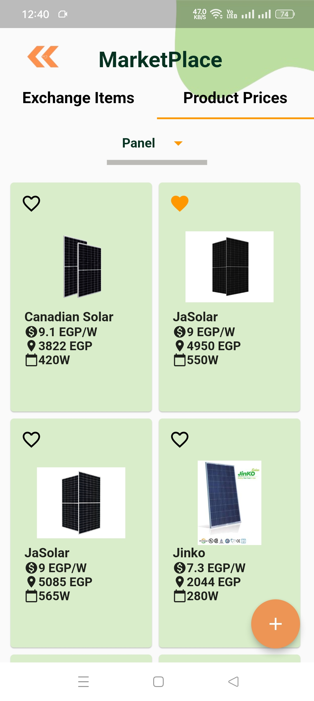
Marketplace(Products)
Allowing users to filter products by category.
The product prices section in the marketplace offers a variety of solar market products, featuring their latest prices, brands, and capacities.
User can mark products as favorites.

Slide 35
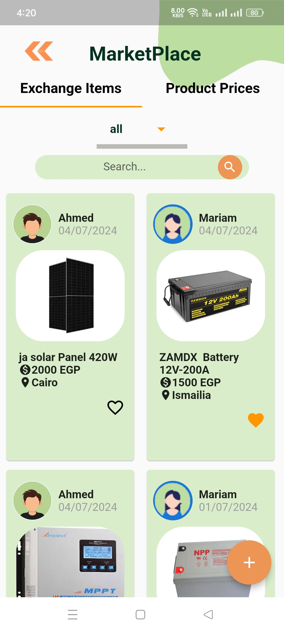
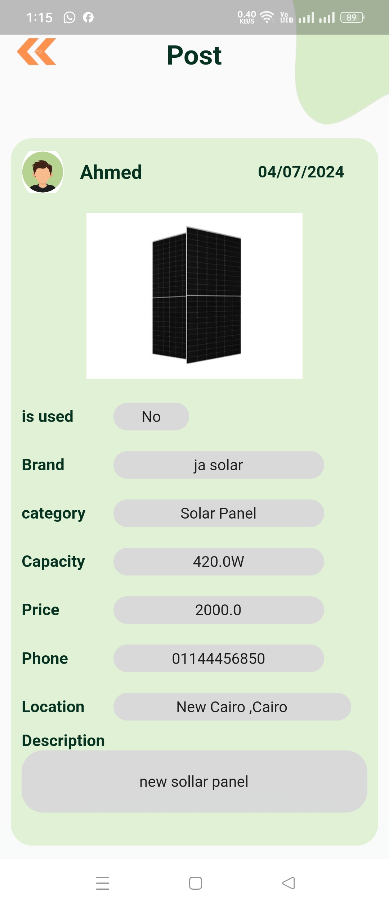
Marketplace(Exchange Items)
They can filter posts based on product categories
They can search by city to find relevant information
User can access each post for more detailed information about specific products
User can browse summarized posts of solar products for quick overviews.
User can mark posts as favorites.
User can add new post for selling solar product.

Slide 36
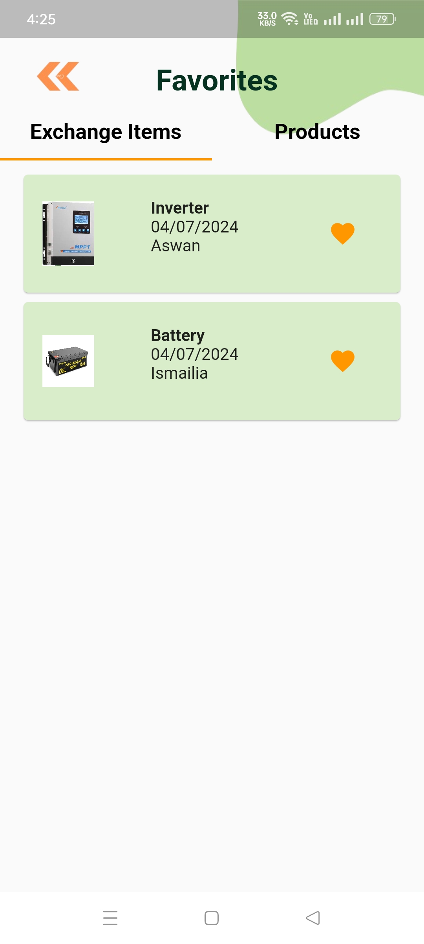
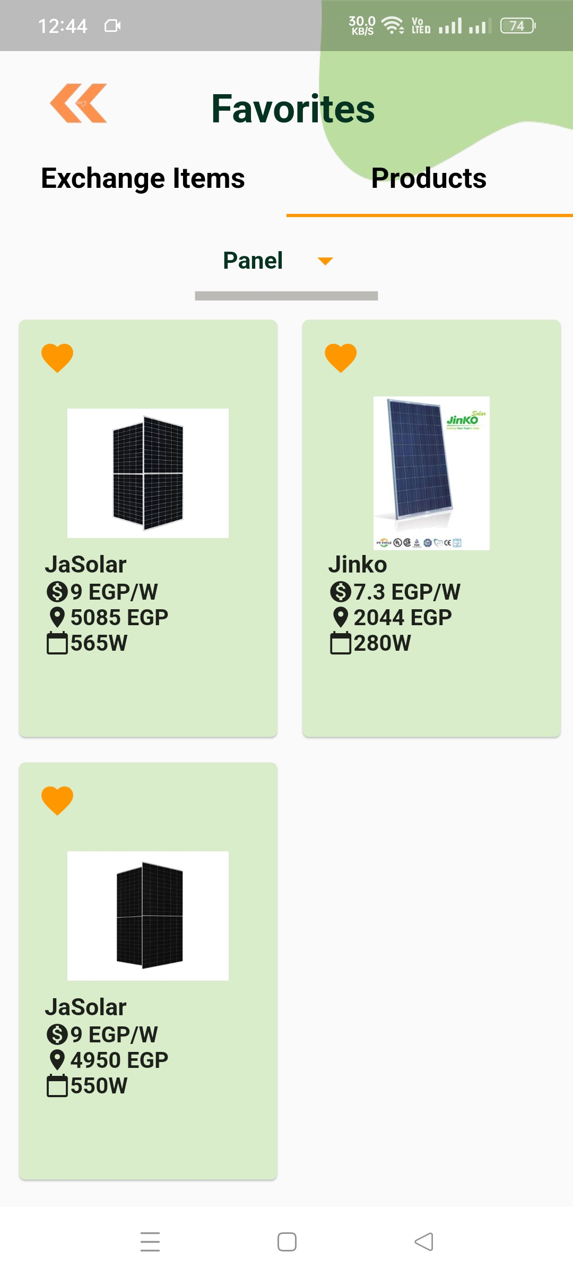
Favorites
Offers filtering by category
User can view their favorite posts for easy reference and comparison on their favorite posts page.
User can view their favorite solar products for easy reference and comparison on their favorite products page
User can also access post for more detailed information

Slide 37
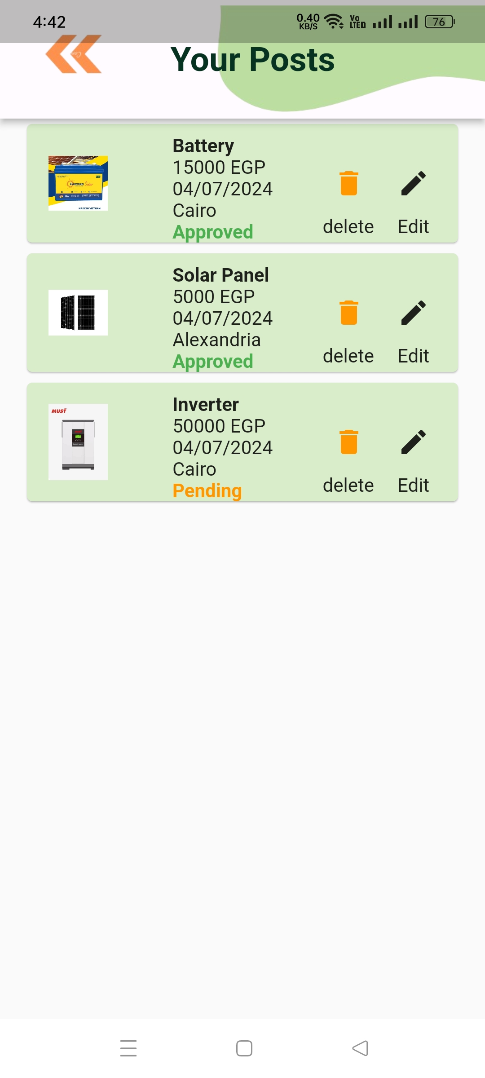
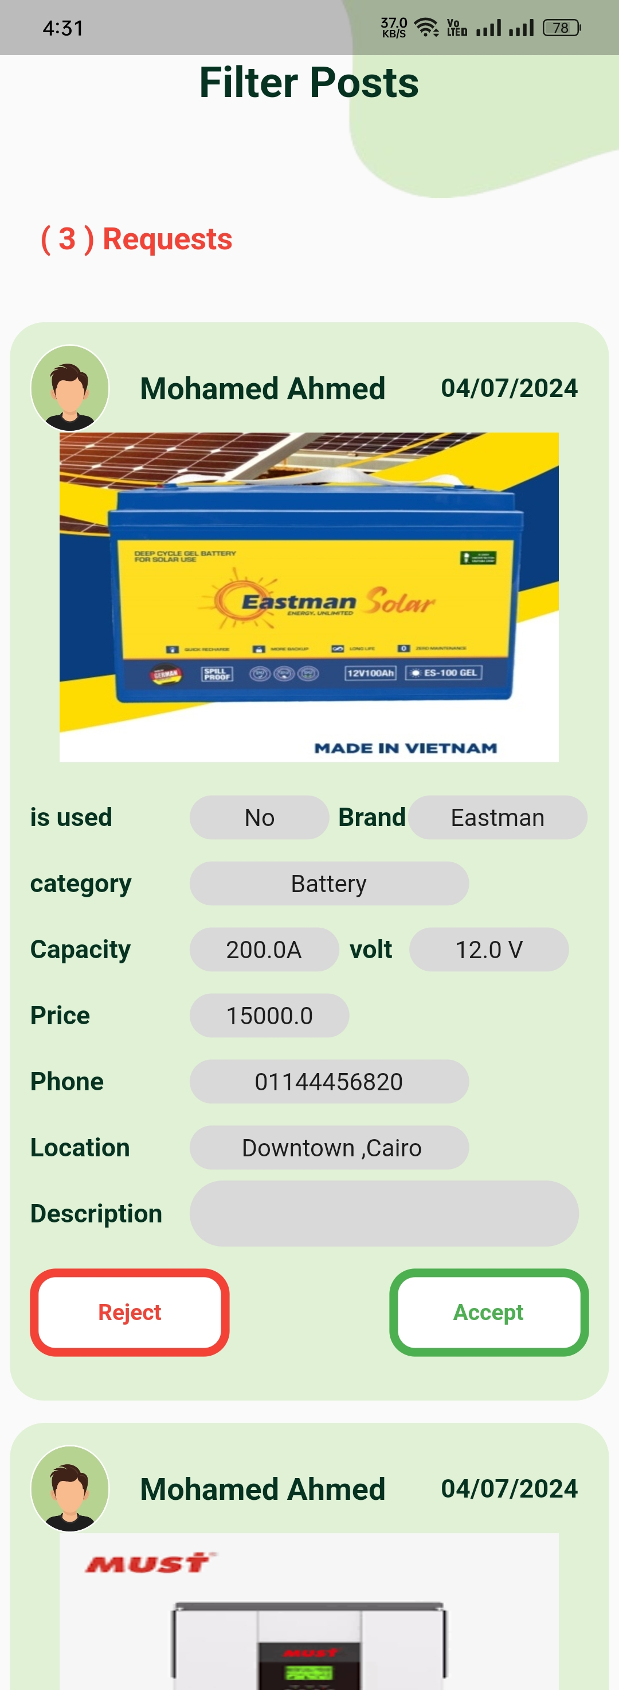
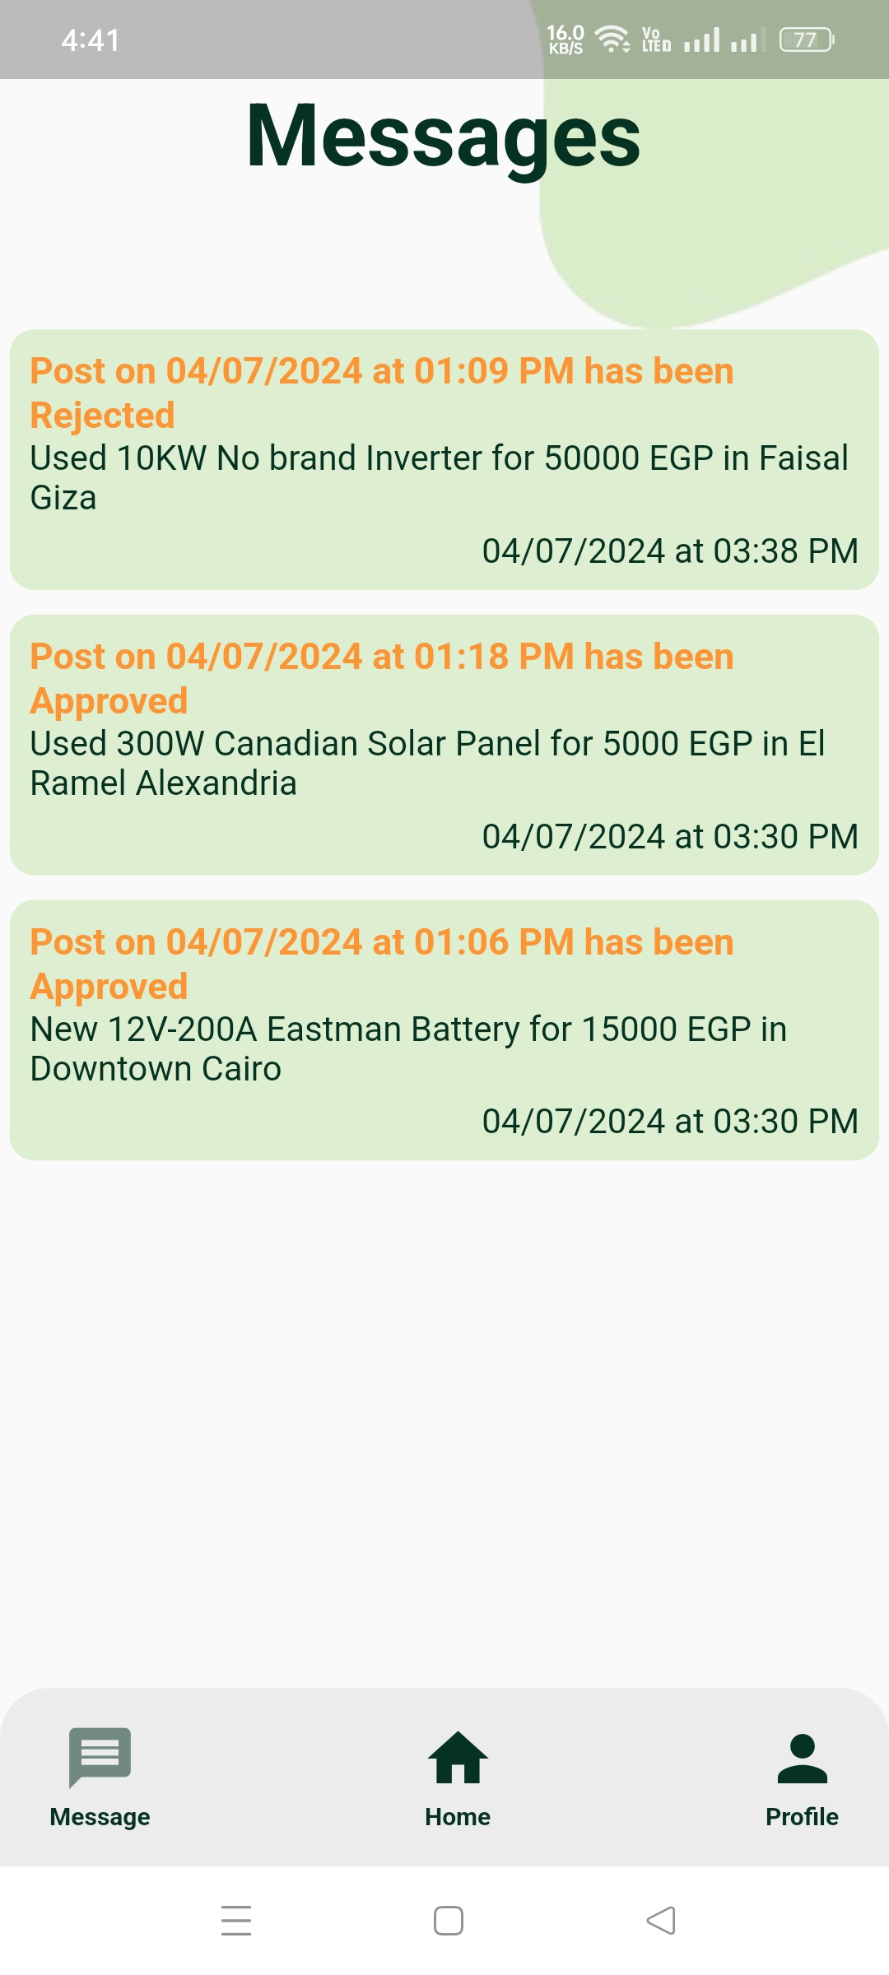
Posts
User can view and manage their posts, check the approval status, update or remove posts from marketplace.
Users receive a message regarding the approval or rejection of their post, along with an email.
When users submit a post, it waits for admin approval to make sure it meets quality and marketplace rules.

Slide 38



Future Work
1.
Increase dataset diversity by integrating multiple meteorological sources for detailed local coverage. Start with Cairo and Giza, then expand to rest of governorates.
2.
Explore advanced regression algorithms like Random Forests and Gradient Boosting for improved predictions.
3.
Integrate paid OpenWeather API versions for enhanced hourly and daily data availability across Egypt.
4.
Implement online payment integration in the marketplace for seamless consumer-to-consumer transactions.

Slide 39
Challenges & Solutions
For Both Hourly and Daily Models
Data Availability and Quality
Challenge: Meteorological data is often rare, unavailable, or inaccurate
Solution: Use NASA POWER datasets for reliable governorate-wide data.
Handling Temporal Features
Challenge: Capturing cyclical nature of time-related features.•
Solution: Apply cyclical transformations (sine and cosine) to temporal data.

Slide 40
Challenges & Solutions
For Hourly Model
Handling Nighttime Data for Solar Irradiance Predictions
Challenge: Nighttime data, where solar irradiance is absent, introduces noise and biase•
Solution: Filter out nighttime hours (5 a.m. to 8 p.m.) to improve prediction accuracy.
For of OpenWeather API
Lack of Meteorological Data
Challenge: OpenWeather API provides meteorological data at 3-hour intervals, limiting direct daily and hourly weather predictions.•
Solution: Implemented preprocessing to aggregate 3-hour data into daily averages for accurate daily weather predictions, while adjusting to provide predictions at 3-hour intervals for hourly forecasts.

Slide 41
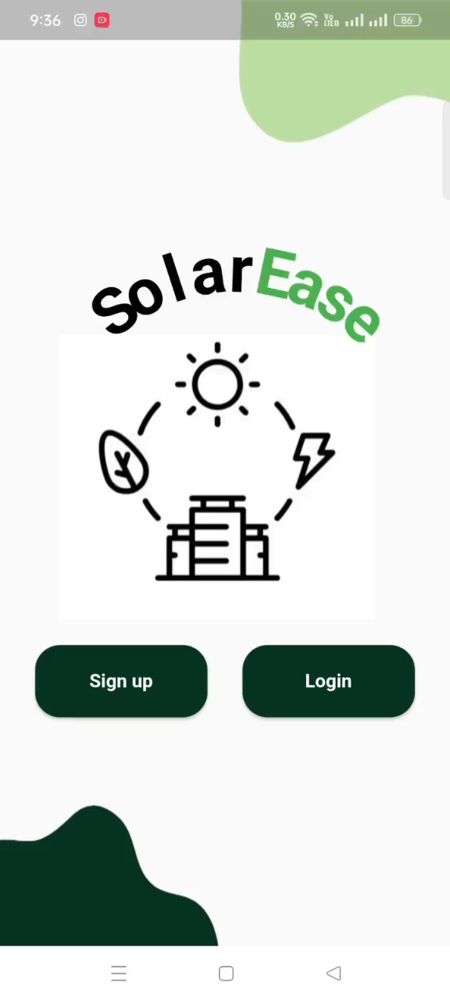
Video Demo

Slide 42

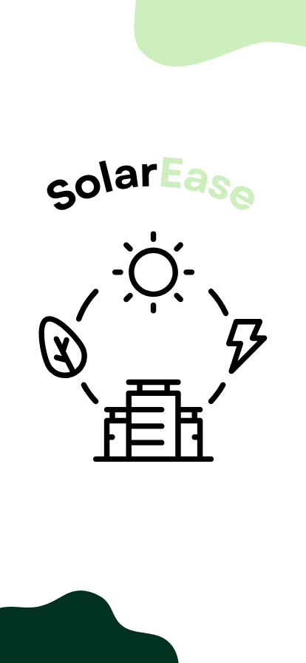


Thank You
Do you have any questions?

